Slide 1
What is Consciousness?
Searle: “Consciousness consists of inner, qualitative, subjective states and feelings or awareness”
Qualitativeness: “feels like something..”
Subjectivity: each person has their own, cannot be experienced outside of a being..
Unity: single unified experience at each moment: not disjointed grab-bag of uncoordinated stuff..

Slide 2
The “hard problem”
Chalmers: How does a physical system (the brain) produce this amazing thing we experience as consciousness?
In other words, can we come up with an objective understanding of subjective experience?
Vs. “easy” problems: ability of system to access its own internal states, report on them; ability to focus attention; deliberate control of behavior…

Slide 3
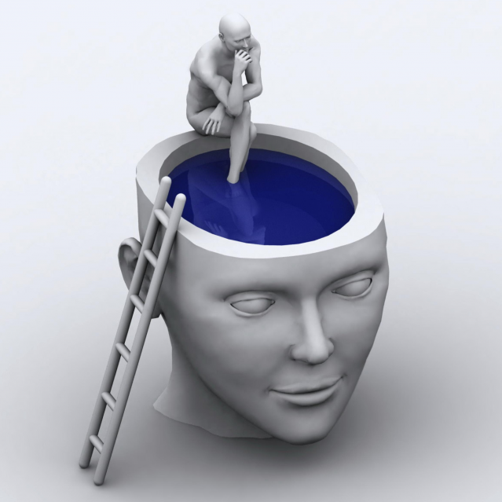
Metacognition
Awareness of awareness is also a key ingredient of human consciousness – likely associated with prefrontal cortex and other high-level brain areas.
Are you conscious when you’re not “mindful”?

Slide 4
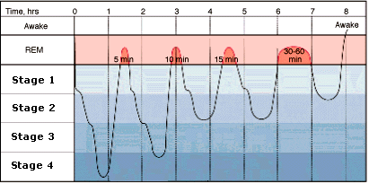
Sleep and Dreaming
Deeper = slower frequency brain waves (Theta -> Delta)
REM & Awake = Beta, Alpha, Theta

Slide 5
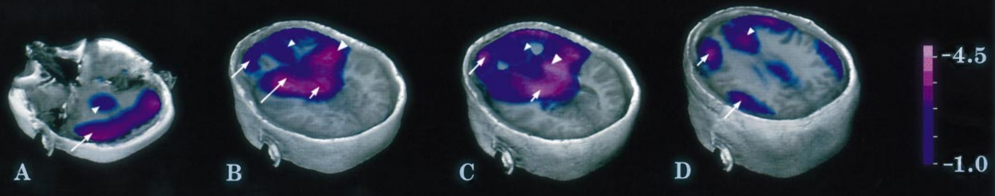
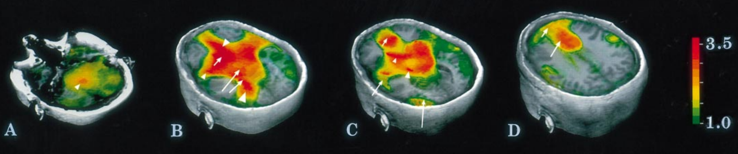
Your PFC Goes to Sleep
And your limbic system wakes up!
Dreams are disorganized, inconsistent over time
And very emotionally charged: lots of fear and lust..
Braun et al, 1997: http://brain.oxfordjournals.org/content/brain/120/7/1173.full.pdf

Slide 6
Why do we sleep?
Synthesize proteins in synapses, etc:
Use your brain during the day, (re)build your brain at night
Why babies sleep so much..
Result = better memory after sleep – “consolidated” synapses

Slide 7
Addiction -> Dependence Terms
Withdrawal: unpleasant feelings from lack of use
Craving: overpowering feeling of wanting
Tolerance: progressive need for more to get same effect

Slide 8
Neuromodulators and Drugs (receptor agonists)
Acetylcholine (ACh): muscles, attention, learning, memory (nicotine)
Dopamine (DA): when to learn, based on reward prediction errors (cocaine)
Norephinephrine (NE): attention, engagement (speed)
Serotonin (5HT): Mood, sleep, appetite, sex, stress (SSRI, LSD = waking dream)
Oxytocin: social modulation, labor (pitocin)
Endorphins, Substance P: pain (heroin)
GABA: inhibition (benzo, valium, etc)

Slide 9
Drugs (receptor agonists)
Narcotics: Opium derivatives (heroin, morphine..): opioid receptor agonists
Depressants: Benzo, Valium: GABA inhibition agonists
Stimulants: nicotine (ACh receptor agonist), cocaine (Dopamine receptor agonist), amphetamine (Norepinephrine + receptor agonist), caffeine (Adenosine antagonist -> Dopamine agonist)
Psychedelics: LSD, peyote, mescaline, psilocybin: affect serotonin; Marijuana: cannabanoid receptors

Slide 10
Textbook Taxonomy of Learning
Non-associative: Habituation / Sensitization
Less response vs. More response over time
Associative:
Classical conditioning: assoc Stimulus -> Outcome
Operant conditioning: assoc Action -> Outcome

Slide 11
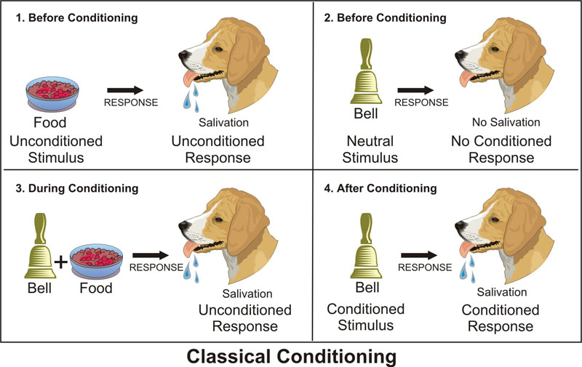
Classical Conditioning
US
UCR
CS
CR
CS associated with US, thinking of US drives CR

Slide 12
Conditioning Terms
Acquisition: initial learning of CS -> US Assoc
Second order: CS1 -> CS2 -> US
Generalization: anything kinda like CS does it..
Discrimination: CS1 -> nothing, similar CS2 -> US
Extinction: learning that CS !-> US anymore
This is NEW learning, not UN-learning!
Spontaneous recovery of extinguished learning
Renewal from exposure to other contexts

Slide 13
Limits of Classical Conditioning
Biological Preparedness: built-in pathways for CS’s and US’s
Food can cause nausea, lights / tones shock, but not the other way around!
Conditioning is not mere association:
CS must reliably predict US! Requires more advanced (“cognitive”) statistics..

Slide 14
Operant / Instrumental Conditioning
Thorndike’s Law of Effect:
Actions -> Good stuff are “stamped in”
Actions -> Bad stuff are “stamped out”
Dopamine = Good (bursts) vs. Bad (dips/pauses) drives learning in Basal Ganglia in accord with Law of Effect!

Slide 15
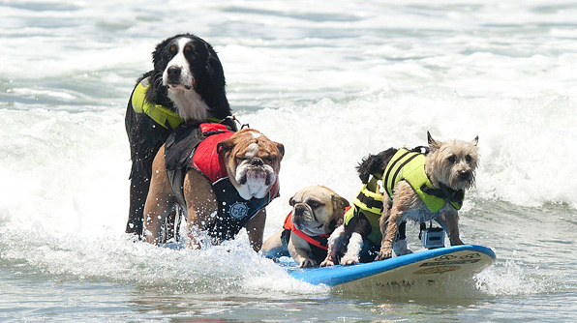
Operant Tricks
Secondary Reinforcer (e.g., $$): something associated with actual Primary Reinforcer
Shaping (by successive approximation) – it’s
how you get here:
NOT going to ask about Reinforcement Schedules (VR, VI, etc)

Slide 16
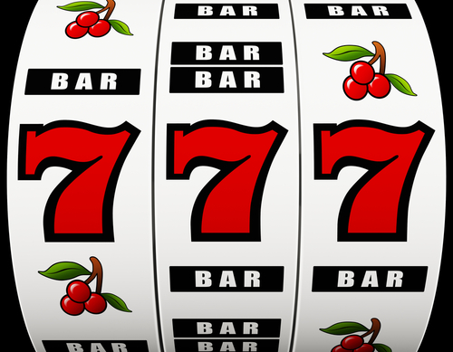
Partial Reinforcement!
Keeping your dopamine in the zone..
Dopamine learns
to expect anything
reliable and “cancels”
it out

Slide 17
Observational Learning
Imitation, Modeling, Vicarious Conditioning: Socially-transmitted learning signals!
Mirror neurons: neurons that respond the same when you do an action as when someone else does it!
Does this mean when we watch violent media, we act more violent??

Slide 18
Latent Learning
Humans exhibit massive amount of “latent learning” in neocortex and hippocampus: learning that is not reinforced and not obvious in behavior
Only a tiny bit is ever expressed in behavior
Much of it is evident in rich, elaborate dreams
Or when people sit down and write novels..

Slide 19
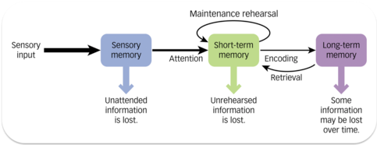
“Modal” Model
Sensory: iconic (visual, 500msec max), echoic (auditory, few sec)
STM: ~20 seconds max, limited capacity (3-4 really, 5-7 for verbal)
LTM: essentially unlimited capacity

Slide 20
“Modal” Model Dynamics
Sensory & STM do not need to be encoded or retrieved: Active..
LTM does need to be encoded and retrieved: Offline
Sensory -> STM requires attention
STM = transient, needs rehearsal to maintain

Slide 21
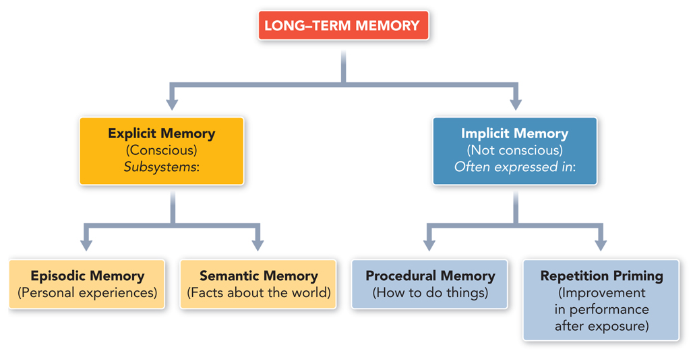
Organization of LTM
Is this the best way to organize LTM? Can you think of any other ways?

Slide 22
Chunks!
OWA… TAJER… KIAM…
SBCVTMCBNOBH vs. HBONBCMTVCBS
Organizing information into chunks = bigger
Memory Span
SF was able to remember 110 random digits by chunking into running times, etc.

Slide 23
Encoding and Remembering
Deeper encoding = better memory
elaborative encoding (e.g., method of loci – put each thing in its own special place)
Levels of processing framework: is that all? No..
LTM can be very context dependent (why?)
- state-dependent = a kind of context..

Slide 24
Working Memory vs. STM
Working memory = activity in PFC reflecting stuff you are actively working on
Working memory is a special kind of STM: because PFC is special in not being so easily distractible

Slide 25
Seven Sins of Memory
Transience: yep, you forget
Absentmindedness: pay attention!
Blocking: tip-of-the-tongue phenomenon
Misattribution: she’s not very nice
Suggestibility: memory implants..
Bias: true memory overwritten by desired memory
Persistence: only the ones you don’t want..

Slide 26
Is Memory Accurate
Why should it be?
Are you a computer or a video tape machine?
Is your perception accurate in the first place?
Ok, but how bad is it?
Change blindness: You are not even encoding much of anything in the first place!
And then you don’t remember much beyond that!

Slide 27
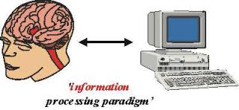
Computational Theory of Mind (‘60s)
The brain is NOT very much like a computer
And yet both are information processing systems!
Cognitive Science (ICS at CU): Psych & Neurosci, Linguistics, Philosophy, Computer Science

Slide 28
System 1, 2
System 1: posterior cortex – domain-specific knowledge and fast processing
Previously known as automatic processing
System 2: prefrontal cortex – general purpose cognitive processing and problem solving (slow)
Previously known as controlled processing
(It takes a Nobel prize to reinvent a well-established distinction, using much worse terms!)

Slide 29
More Dichotomies
System 1 = Automatic = Crystalized Intelligence = posterior cortex with well-tuned synapses over a lifetime of experience (wise..)
System 2 = Controlled = Fluid Intelligence = prefrontal cortex & basal ganglia with strong ability to rapidly update and maintain information in working memory

Slide 30
IQ Scales and History
Stanford-Binet: first IQ test (Alfred Binet)
WAIS-III: Wechsler Adult Intelligence Scale: first IQ test for adults
Spearman: Indifference of the Indicator: “smart” people do well on any test: g = general IQ factor
IQ is single best predictor of grades, SAT tests, educational outcomes. Correlated with health. But not best predictor of job performance.

Slide 31
Multiple Intelligences
Sternberg: Triarchic = analytic, creative, practical
Carroll: Three-stratum (g, 8 more specific, and then 69 even more specific)
Fluid intelligence (Gf = PFC, g) vs. Crystallized (Ge = posterior cortex, knowledge, wisdom)

Slide 32
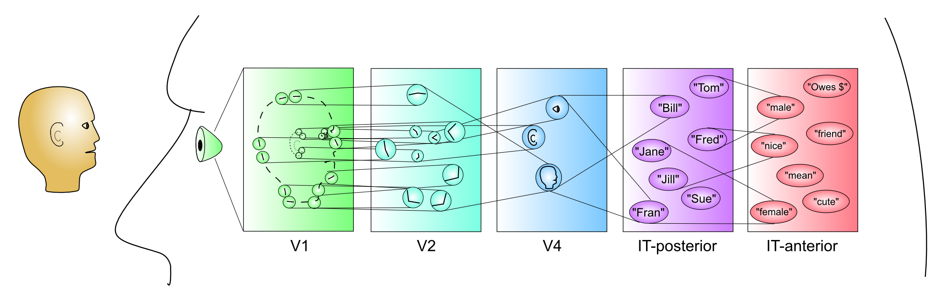
Thought & Problem Solving
Thought = deliberate manipulating information to solve problems, make decisions, etc. Consists of:
Mental Images: picture-like representations
Concepts: mental categories (CCCC=compr.)
Images
Concepts

Slide 33
Problem Solving Terms
Trial and Error: try and see what works..
Algorithm: like a program – problem solving = search algorithm (chess..)
Heuristic: short cut “rule of thumb” that often works without solving the hard problem
Source of a lot of cognitive biases?

Slide 34
Availability Heuristic
Whatever comes to mind, go with that! Much easier than figuring out the actual statistics!
Problem: not very accurate..

Slide 35
Representative Heuristic
Compare how similar to a prototypical case
Problem: tend to ignore base rates.
And rely on stereotypes

Slide 36
Confirmation Bias CCCC = Control!
Only pay attention to information consistent with our preexisting beliefs!
Astrology, politics, .. Everywhere!
Filter bubble = more and more of a problem in modern digital media!
Belief Persistence: just plain ignore / discredit inconsistent information!
Why? Our beliefs are central to our feeling of control and identity: challenge is very threatening!

Slide 37
Gambler’s Fallacy
Belief that: If you’ve just been losing, you’re more likely to win! (Or vice-versa)
But, probability of heads is always 50% no matter how many heads or tails have come before!
Interestingly: probability over time of HH vs HT is NOT the same!! This is likely basis of this fallacy.
https://grey.colorado.edu/CompCogNeuro/index.php/SunOReillyBhattacharyyaEtAl15

Slide 38
Language is Special
Symbols: Displacement (talk about un-present)
Syntax: Rules and Generativity (to infinity!)
Recursion: Embedded levels of structure:
“The horse raced past the barn fell”
"Isn't it true that example-sentences that people that you know produce are more likely to be accepted?”Temporally-extended sequences
Cultural transmission

Slide 39
Chomsky: Universal Grammar
Language is so amazing and special, it must be innate! Can’t possibly learn this from impoverished nature of the environment!?
Internal language faculty: language acquisition device (LAD)
All languages share certain rules (Universal Grammar)
LAD “designed” to learn these rules..

Slide 40
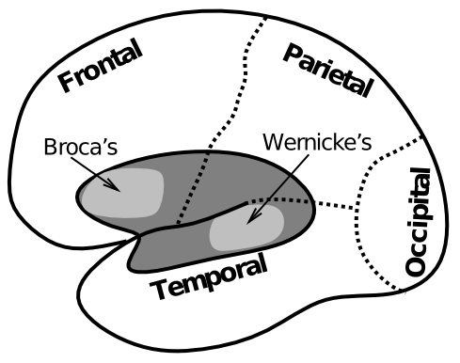
Biology of Language

Slide 41
Example of Wernicke’s Aphasia
"How are you today?”:
"Gossiping O.K. and Lords and cricket and England and Scotland battles. I don't know. Hypertension and two won cricket, bowling, batting, and catch, poor old things, cancellations maybe gossiping, cancellations, arm and argument, finishing bowling.”
https://www.youtube.com/watch?v=aVhYN7NTIKU

Slide 42
Non-human Language
It is all about the motivation: what does a chimp really want from language??
People really want to share, chimps don’t..

Slide 43
Approach vs. Avoid
Approach = left hemisphere = dominant
Avoid = right hemisphere = subordinate
We approach positive outcomes, and avoid negative ones.
Anger is negative: is it approach or avoid?
Need to turn negative into a positive in order to act!

Slide 44
Motivation Terms
Motivation: mental state causing purposive behavior: acting toward a desired goal.
More motivation = more intensity and persistence
Ambivalence = conflicting motivations
Instinct = innate, automatic, triggered by releasing stimuli (cues): fixed action pattern
Problem: circularity. Need richer evolutionary story for survival, propagation relevance..

Slide 45
Drives
Drive: desire to reduce unpleasant state from need (drive reduction theory: Hull, 1943)
Homeostasis: maintain target levels of blood sugar, water, etc. Drive = restore target level.
Maintain optimal arousal level? Not everything is a drive..
Need
(food, water..)
Drive
(hunger, thirst)
Drive-reducing behaviors
(eat, drink)

Slide 46
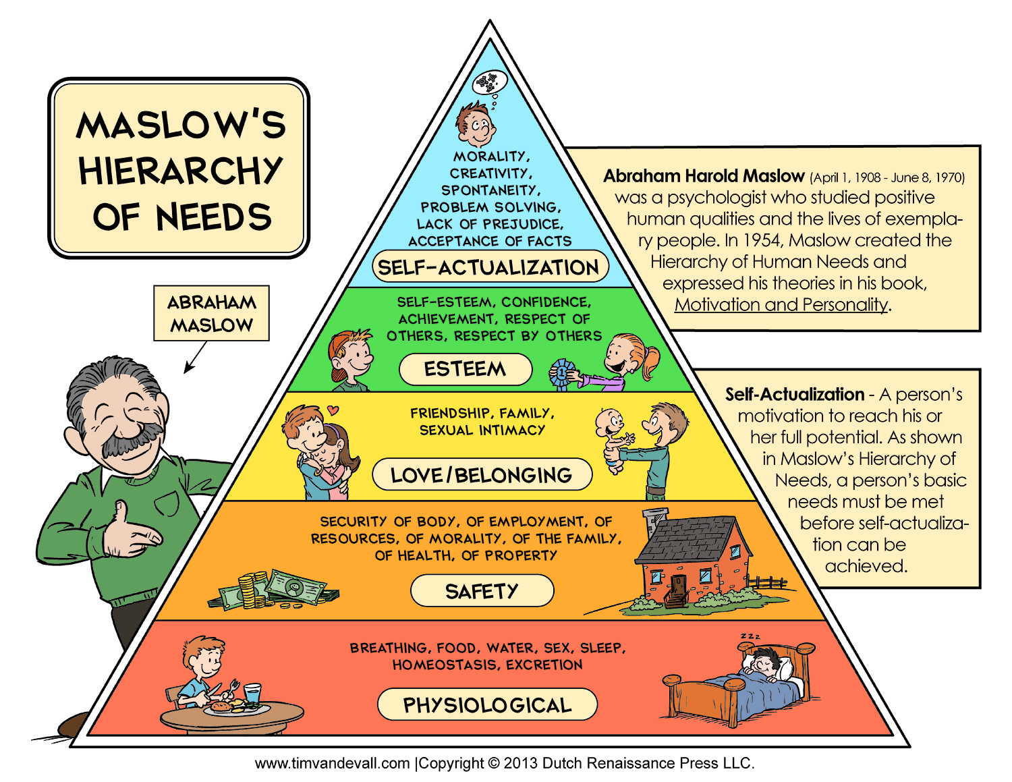
Needs

Slide 47
Needs
Any attempt to define a strict hierarchy will always fail! Death by video games, selfies, etc..
Primary vs. secondary: needed for survival vs. universally experienced but not essential..

Slide 48
Eating Terms
Hunger (homeostatic) vs. Appetite (desire)
Energy balance = in vs. out
Baseline body weight = set point (strongly enforced: when you diet your body reduces metabolic rate to preserve the set point!)
Anorexia nervosa: extreme control over eating
Bulimia nervosa: binge and purge
Eating disorders have genetic, cultural influences

Slide 49
Eating Disorder Causes
I think the single biggest cause of eating disorders is:
A. Genes
B. Images of slim models in media
C. Badge of immunity against abundant food (demonstration of character)
D. Internal feelings of desire for control over eating behavior

Slide 50
Causes of Obesity
Which is the single biggest cause of obesity epidemic:
A. High fructose corn syrup
B. Supersize portions
C. Decreased physical activity
D. Cultural / social group acceptance of obesity (all my friends are obese..)

Slide 51
Work Motivation
Industrial and Organizational Psychology (I/O)
Traits: stable personality factors – conscientious, honest, lazy, aggressive, sociable, shy, etc..
Workaholic: neuroticism, perfectionism, conscientiousness
Perceived self efficacy: If we are good at something, we reinforce that, it becomes part of our self-image.. CCCC = Control! (competence)
Goal-setting theory: specific and difficult goals are good for motivating employees..

Slide 52
Possibly Non-obvious Results
Providing extrinsic rewards undermines intrinsic motivation!
- e.g., rewarding kids for homework?
Emphasizing trait makes people nervous
- “you’re so smart” vs. “you worked hard!”

Slide 53
Social Motivation
Need to Affiliate: we like to have people around (at parties and speeches, but not at beaches..)
Women affiliate under stress, men do opposite
Need to Belong: positive mutual in-group interactions of an enduring nature: key factor in overall happiness.
Loneliness: not as much belonging as wanted
Intimacy: self-disclosure, partner responsiveness

Slide 54
Aggression
Intended harm to others; others intend to avoid; not necc. violent
Instrumental: some other goal; not to harm
Hostile: purpose is to harm, emotionally driven
Men: more direct aggression; Women: indirect
- testosterone?? Not clear.
GAM: traits, situation, emotion, decisions
- frustration is common trigger, but not always

